Slide 1

Mental Health in Data
Global Prevalence and other Relational
Visualizations
Gina Nelson, Alvin Victor, Abigail Jawahar & Miles Holtzman

Slide 2
The Questions We Asked
What are the most prevalent mental disorders in the world?
Is there a relationship between the prevalence of mental health disorders and socioeconomic status?
What countries have the greatest and fewest resources dedicated to treating mental health disorders?
Is there a relationship between mental health disorder prevalence and political and economic freedom?

Slide 3
Defining Mental Disorders
A broad range of ailments generally characterized by a combination of abnormal thoughts, perceptions, emotions, behaviour and relationships with others.
- World Health Organization

Slide 4

Examples
Depression
Anxiety Disorders
Schizophrenia
Attention-Deficit/Hyperactivity Disorder
Autism
Eating Disorders

Slide 5
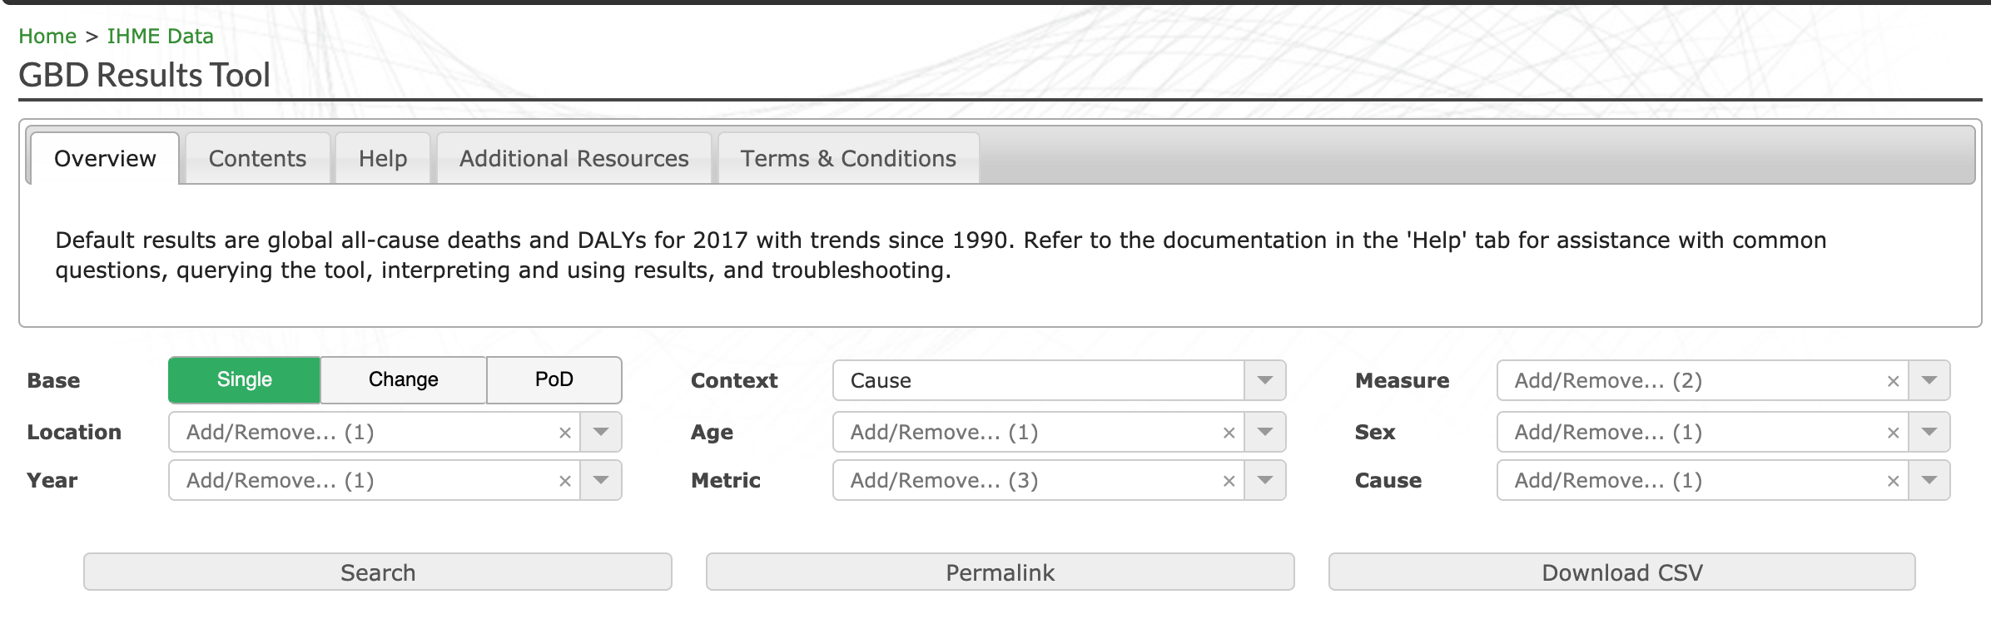
The Data
World Health Organization statistics
Global Health Data Exchange
Global Burden of Disease search tool
Limited to years 2000 - 2017

Slide 6
Global Statistics for Mental Health Disorders
According to the World Health Organization, mental disorders account for 30% of the global non-fatal disease burden.
Close to 10% of the world’s population suffers from anxiety and/or depression.
The economy loses ~$1 T per year in productivity due to anxiety and depression.
Approximately 1 in 5 children and adolescents have a mental disorder and almost half of mental disorders begin before the age of 14.
Around 11% of people in places affected by conflict have a moderate or severe mental disorder.
Mental health workers vary from 2 per 100,000 in low-income countries to 70 per 100,000 in high-income countries.

Slide 7
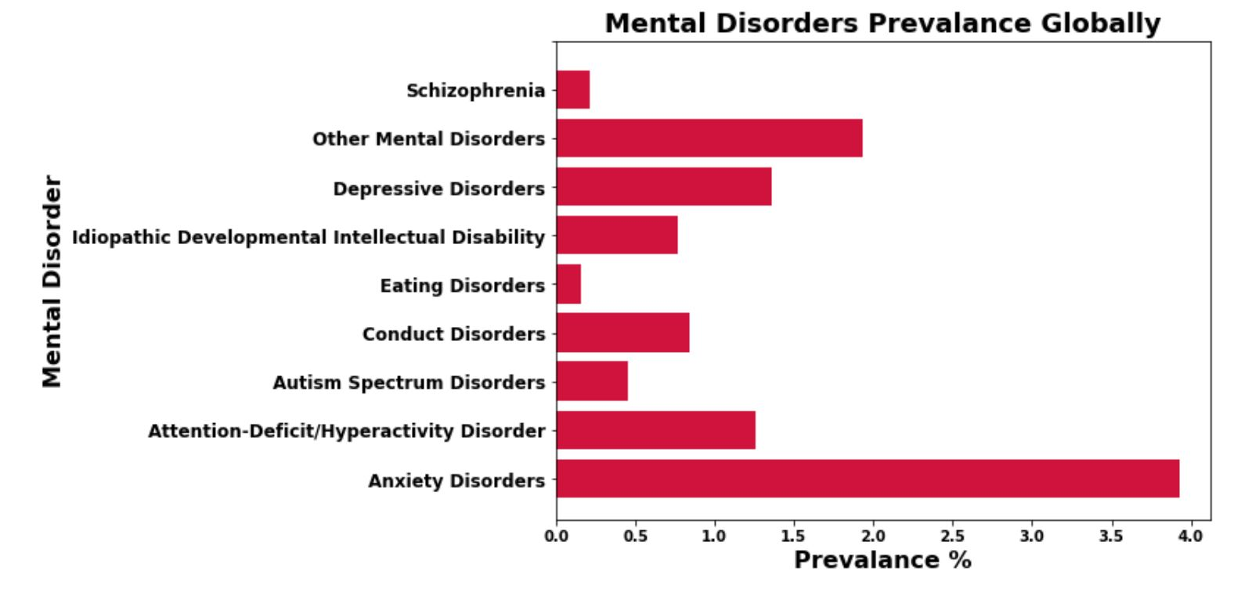
Global Prevalence of Specific Disorders

Slide 8
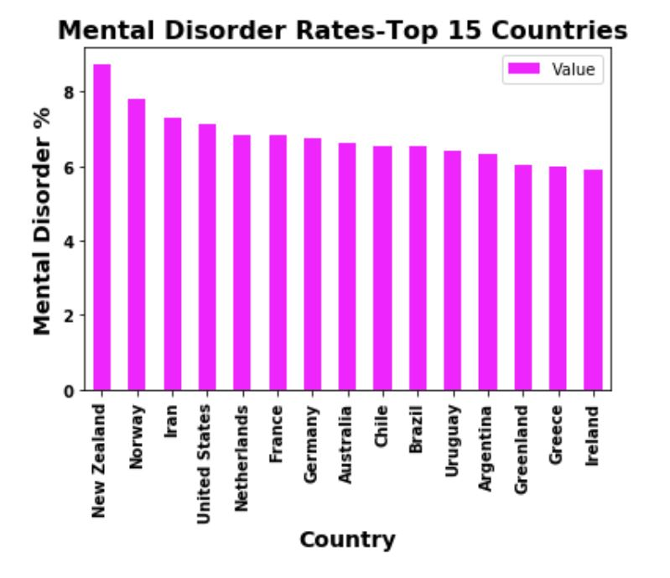
Global Prevalence by Country

Slide 9
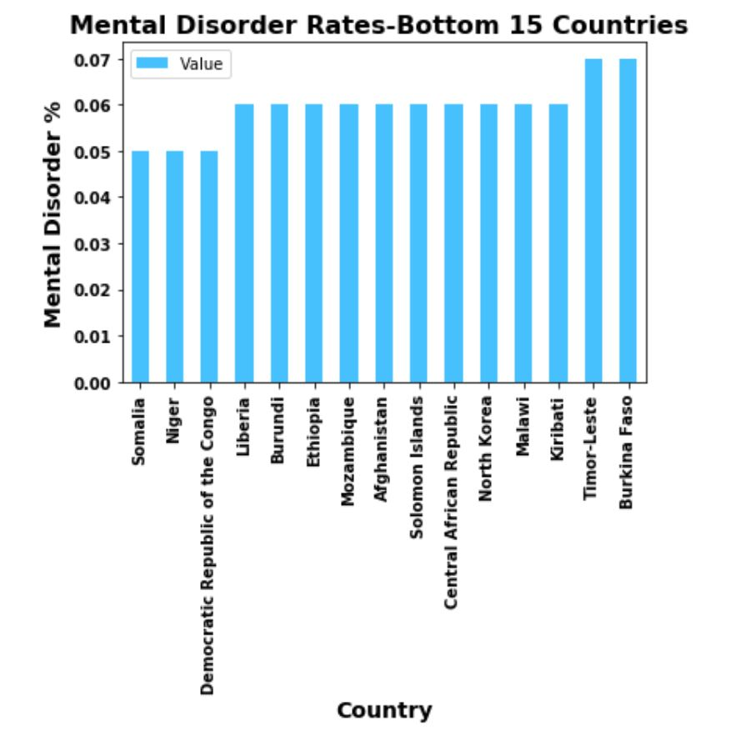
Global Prevalence by Country

Slide 10
Mental Health Disorders and Political and Economic Freedom
”Economic freedom brings greater prosperity…The ideals of economic freedom are strongly associated with healthier societies, cleaner environments, greater per capita wealth, human development, democracy, and poverty elimination”
- Economic Freedom Index

Slide 11

Data Sources
Economic Freedom Index (https://www.heritage.org/index/)
Political Terror Scale (http://www.politicalterrorscale.org/)

Slide 12
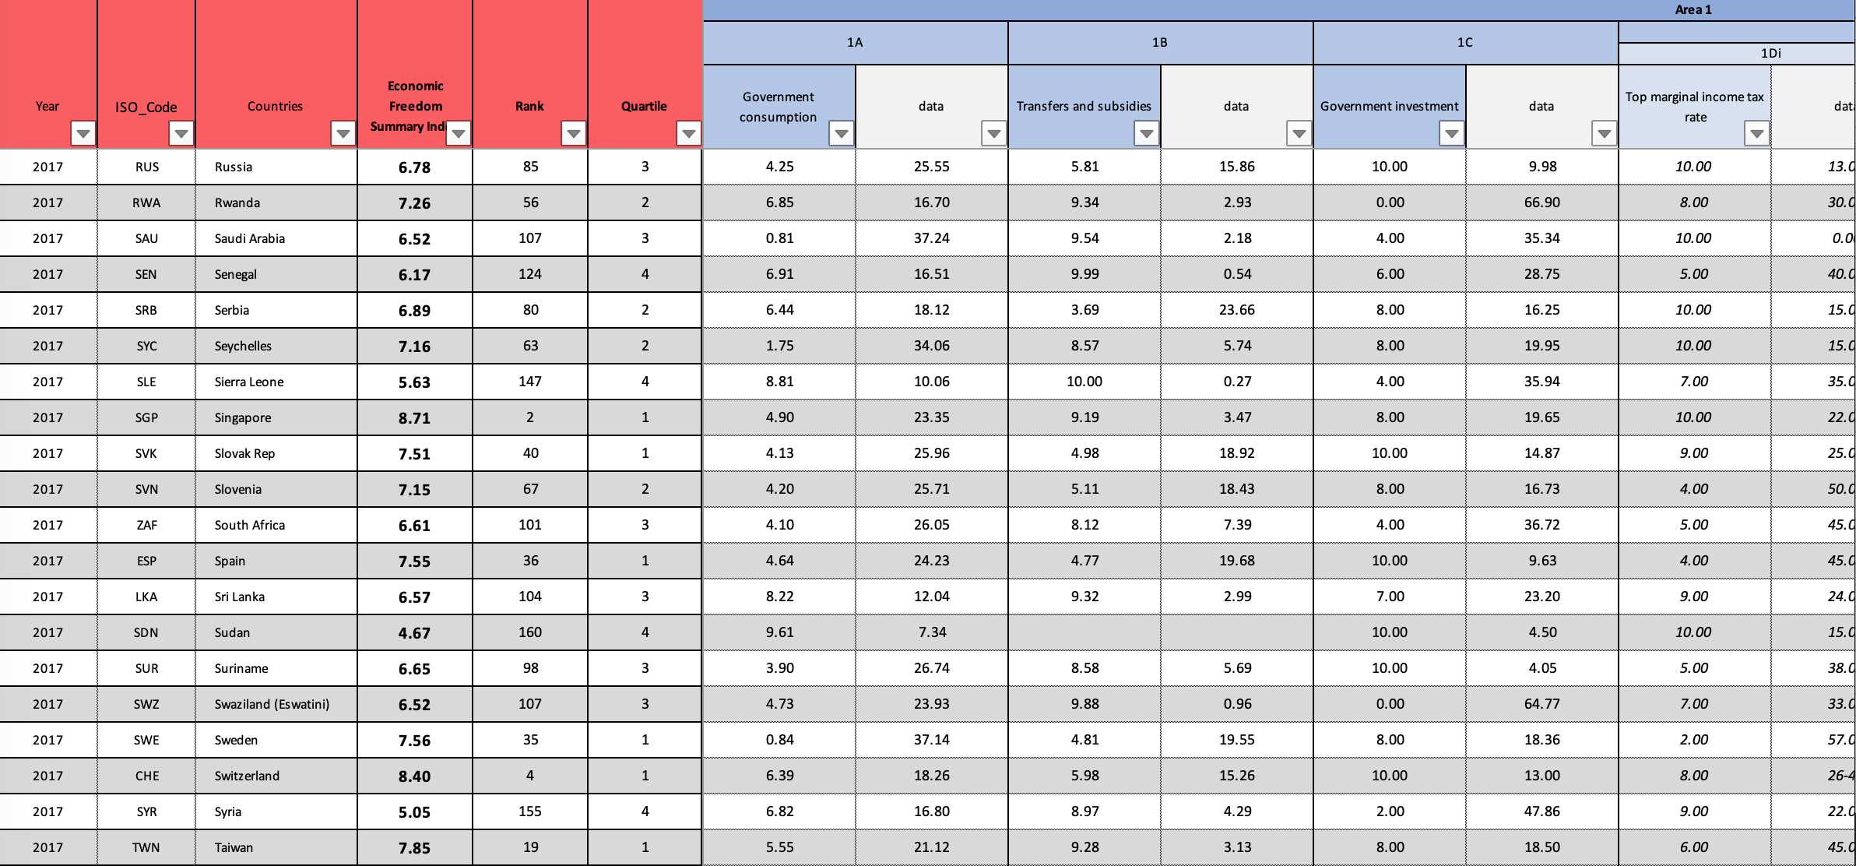
Economic Freedom Index

Slide 13
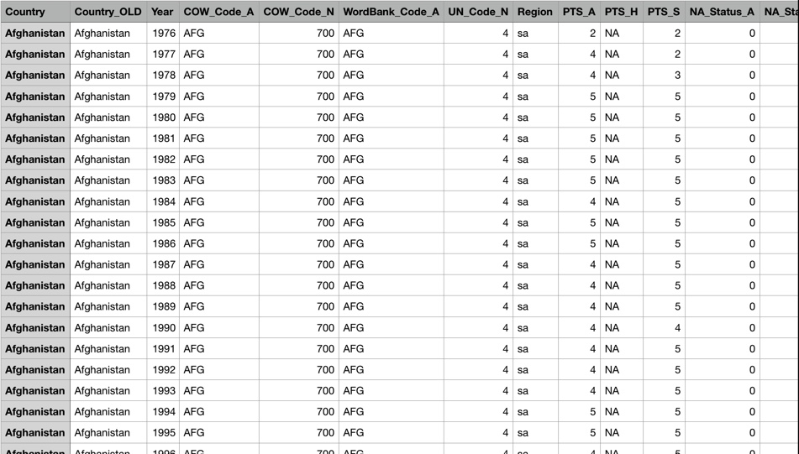
Political Terror Scale

Slide 14
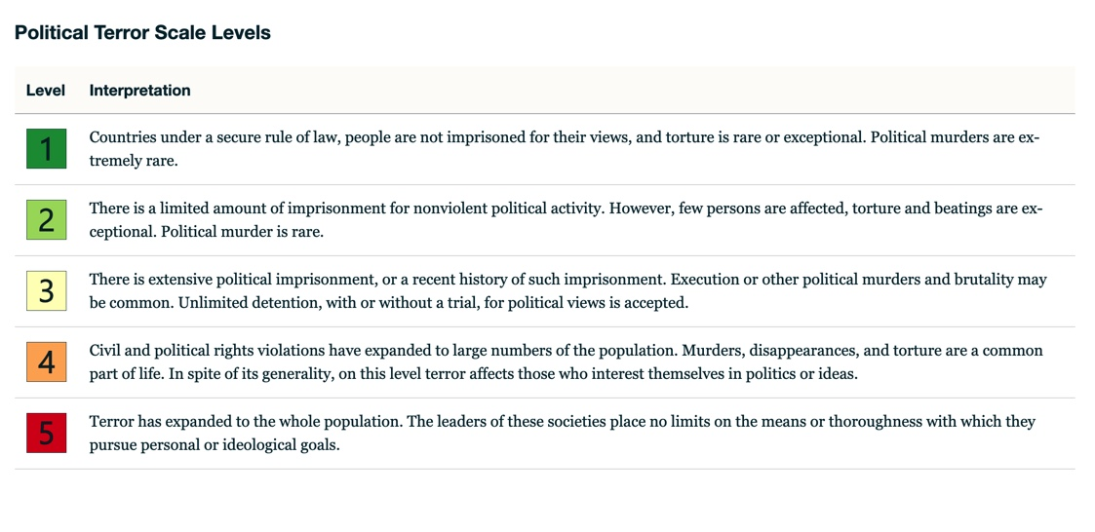
Political Terror Scale

Slide 15
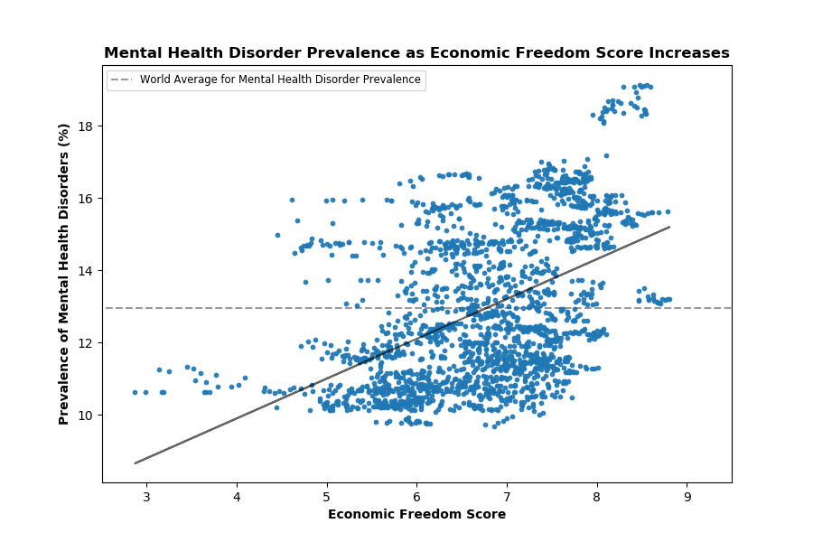
Mental Disorder Prevalence and Economic Freedom

Slide 16
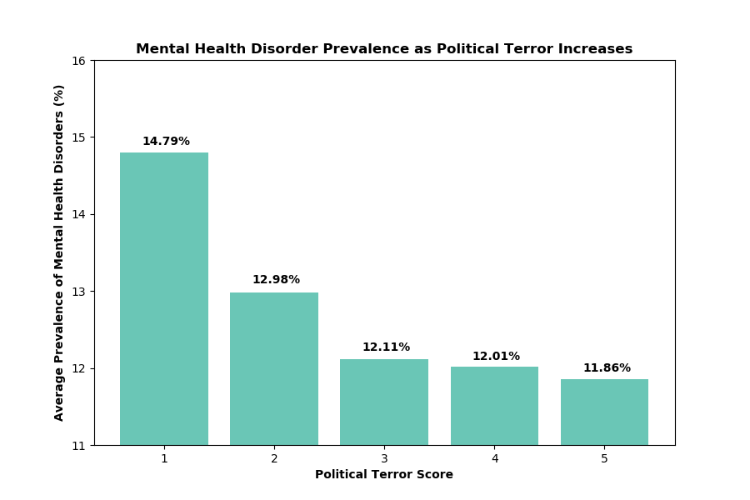
Mental Disorder Prevalence by Political Terror Score

Slide 17
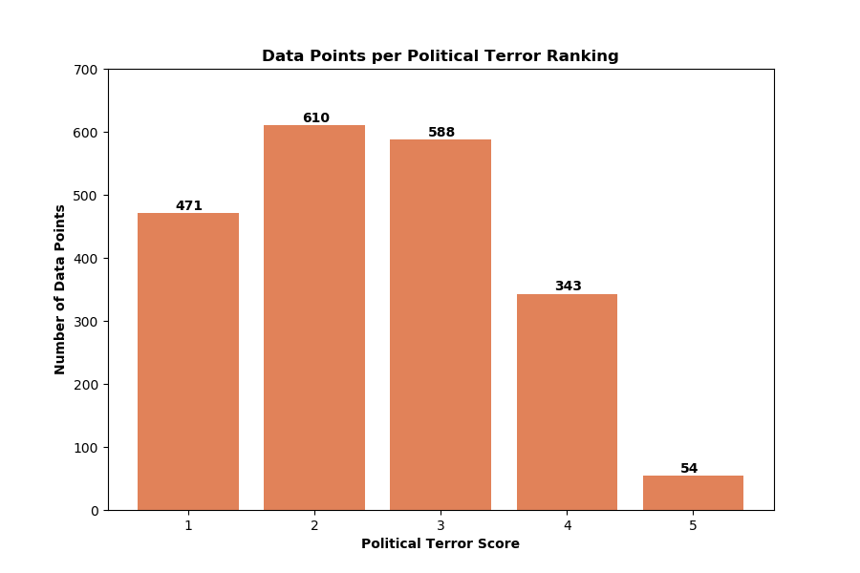
Data Points Reported per Political Terror Ranking

Slide 18
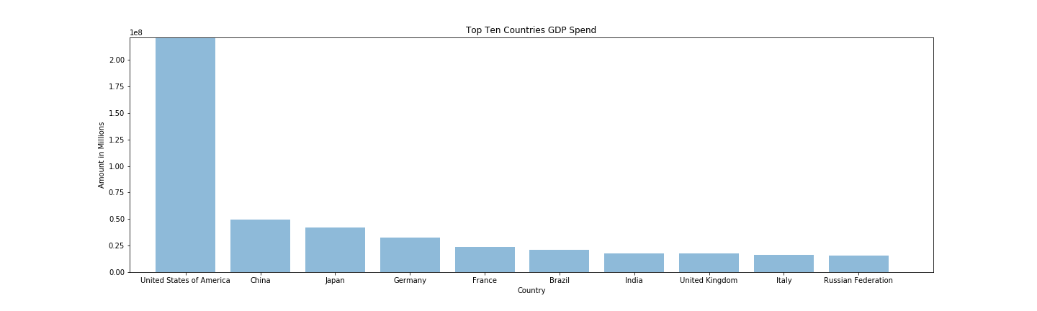
Mental Health Disorder Prevalence and Socioeconomic Status

Slide 19
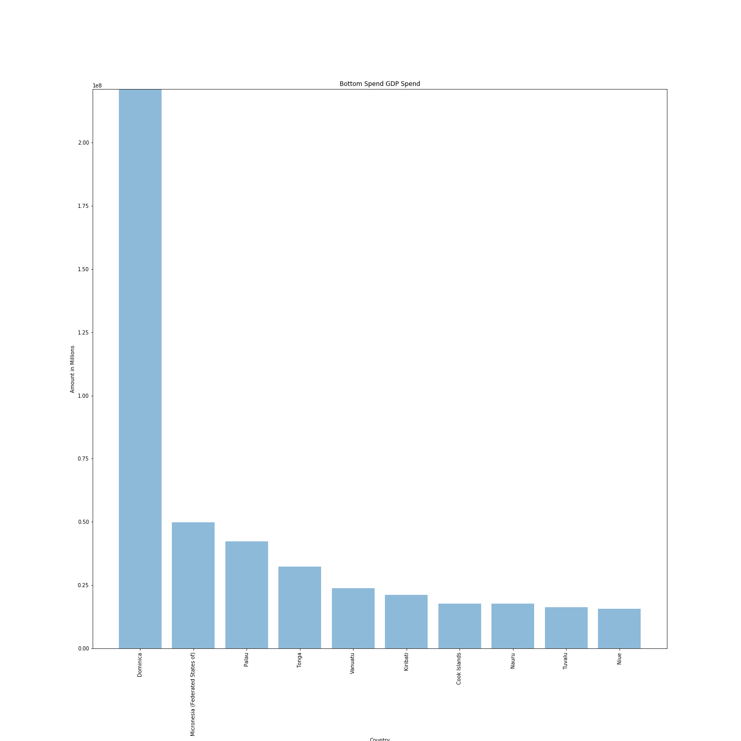
Mental Health Disorder Prevalence and Socioeconomic Status

Slide 20
Mental Health Disorders and Resource Availability/Accessibility
WHO
Number of Psychiatrists working in Mental Health Sector per 100 000 population
Number of Mental Health Outpatient Facilities per 100 000 population

Slide 21
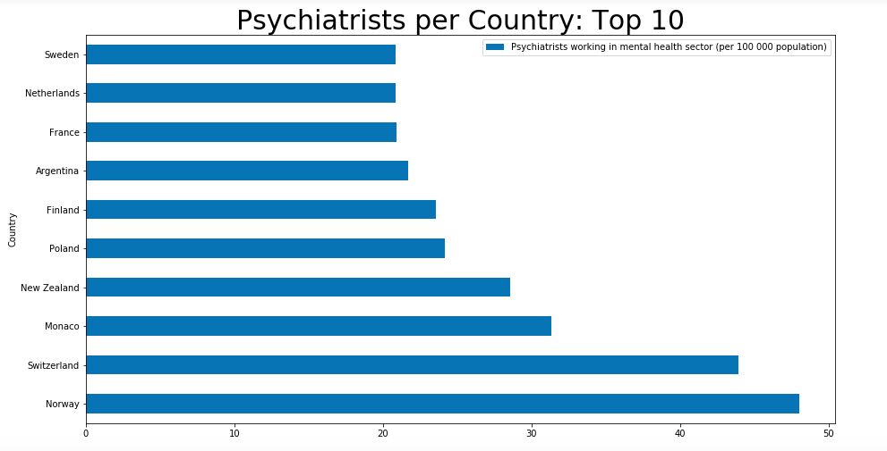
Psychiatrists working in the Mental Health Sector

Slide 22
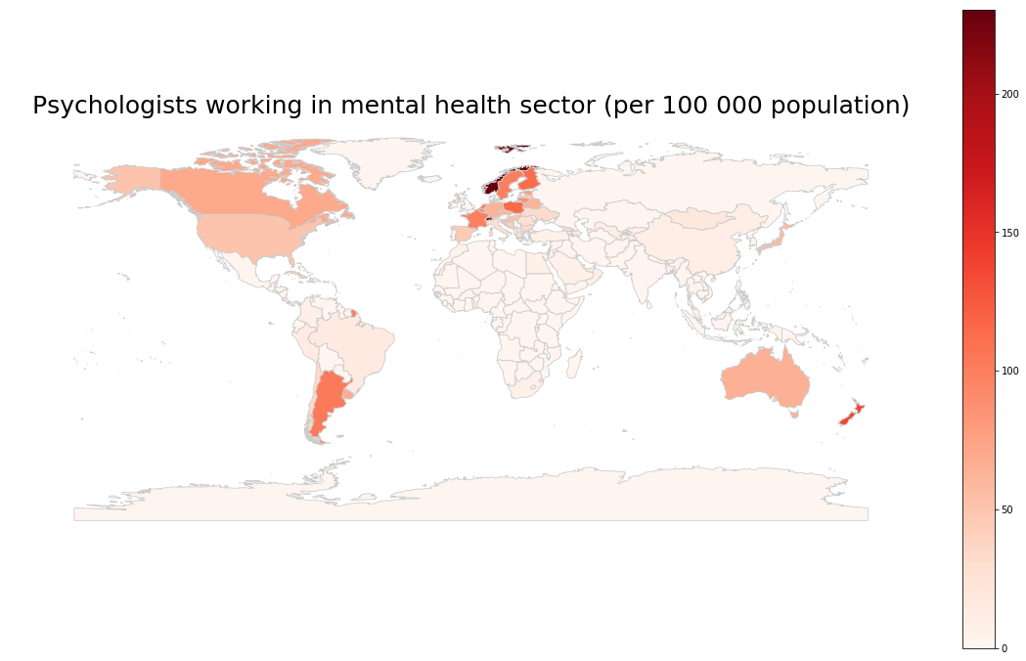
Map of Distribution of Psychiatrists Globally (Using Geopandas & Matplotlib)

Slide 23
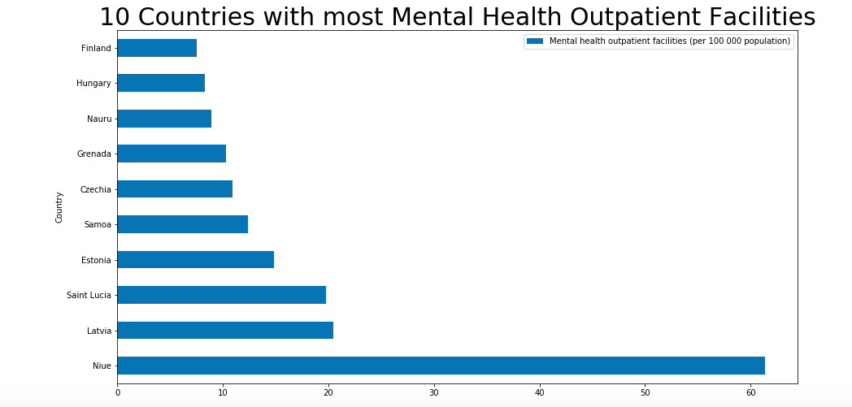
Mental Health Outpatient Facilities

Slide 24
Conclusions
Based on the data, an increase in economic freedom is correlated with an increase in mental health disorder prevalence (correlation coefficient of 0.47)
Exploring mental health is a vast undertaking and each of our segments of exploration are grounds for expansive further inspection.
The time limitation put a ceiling on our ability to further enrichen our analysis.
There were limitations in the data such as gaps in annual data and data that was unavailable for download.

Slide 25
A call for further analysis
A further examination of the relationship between political and economic freedoms and mental disorder prevalence
Outcome based data analysis could be explored to aid the combatting of mental disorders.
Inspecting mental health in children and adolescents data should be studied.
Analyzing links between mental health and substance abuse is necessary.
Investigating suicide alongside mental health seems paramount.
Finding additional data sources to fill in the gaps in our existing data could improve the quality of this analysis.

Slide 26
Helpful Resources for Mental Health
Lastly, if you or someone you know has concerns about their mental health, here are a few ways to get help.
Call the National Suicide Prevention Lifeline: +1.800.273.TALK (8255)
Text the Crisis Text Hotline: “HELLO” to 741741
Talk to your primary care physician for a referral to mental health specialists.
Click here for additional resources:
https://www.nimh.nih.gov/health/find-help/index.shtml

Slide 27
Citations and credits
Global Health Data Exchange, Global Burden of Disease. http://ghdx.healthdata.org/gbd-results-tool
World Health Organization, Global Health Observatory Data Repository. http://apps.who.int/gho/data/node.main
The Heritage Foundation, The 2019 Index of Economic Freedom. https://www.heritage.org/index/
Gib­ney, Mark, Linda Cor­nett, Reed Wood, Peter Hasch­ke, Daniel Arnon, Attilio Pisanò, and Gray Barrett. 2019. The Polit­ic­al Ter­ror Scale 1976-2018. http://www.politicalterrorscale.org/
World Health Organization, Mental Health , Retrieved December 11, 2019, from https://www.who.int/news-room/facts-in-pictures/detail/mental-health
National Institute of Mental Health (2019). Mental Disorders and Related Topics. Retrieved December 10, 2019, from https://www.nimh.nih.gov/health/topics/index.shtml
National Institute of Mental Health (2019). Help for Mental Illnesses. Retrieved December 12, 2019, from https://www.nimh.nih.gov/health/find-help/index.shtml
World Health Organization. (2016, April 13). Investing in treatment for depression and anxiety leads to fourfold return.[Press release]. Retrieved from https://www.who.int/news-room/detail/13-04-2016-investing-in-treatment-for-depression-and-anxiety-leads-to-fourfold-return

